Slide 1
An order-ambivalent presentation-dependent allocation of operators to solving vacuum and gravity problems
Maximilian Weinhold

Slide 2
A disclaimer
This composition of stars is one among many.
Meaningfully to allow predictions we expect messages to appear in time, and with a certain precision. Curiously, only transmission of a message, as against reception or ‘saved’ messages, is needed to fully construct an outer bound – the author thinks a recipient is not intrinsically specified.
Conceiving of a patch as a ‘not-type’ object, it is readily detected in resultant 0 processless process – such as Process(initcheck:Bekenstein, … while(Hawking), f(Page), …) - a process as unable to glean a single program – except for halftime or scrambled. Given a semantic or composite reference without bare object creation.
The author provides a means to pre-detect a singularity in code as a construction against a 1 operator.

Slide 3
* ; 0 ; 1*
An interaction defined through its definition.
A limiting reference
An amplifying reference
; * is amplifying

Slide 4
* ; a, b ; A / B ;A,B/=0 ; A*B / A / B
; * is multiplying and neither A nor B are 1.

Slide 5
* ; A/b ; A*B
If A or B = 0
A*B determinately 0 .
If A or B = 1
A*B = 1 xor (A xor B)
; * is multiplying

Slide 6
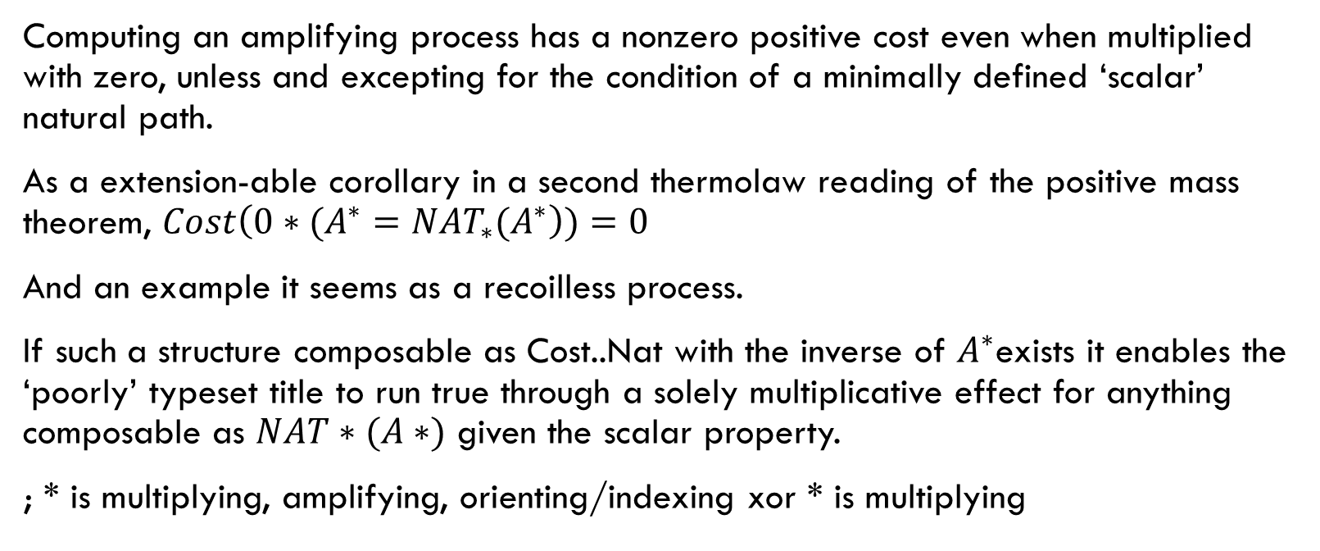
* ; cost(0*A*) > 0 xor Nat*(A*);A*NAT*(1*)=NAT(A*1) == TRUE
Computing an amplifying process has a nonzero positive cost even when multiplied with zero, unless and excepting for the condition of a minimally defined ‘scalar’ natural path.
As a extension-able corollary in a second thermolaw reading of the positive mass theorem, $Cost\left(0∗{(A^{∗}=NAT_{∗}(A}^{∗}\right))=0$
And an example it seems as a recoilless process.
If such a structure composable as Cost..Nat with the inverse of $A^{∗}$exists it enables the ‘poorly’ typeset title to run true through a solely multiplicative effect for anything composable as $NAT∗(A∗)$ given the scalar property.
; * is multiplying, amplifying, orienting/indexing xor * is multiplying

Slide 7
v*(Type,~Type)
V+V = V
aV = V xor 0
V-V = V xor 0
:VVVVVVVVVVV…(Type, ~Type) = 1 xor 0 xor ~ : typecheck
VxV=V xor VV xor VVV xor … (.)
; a singular V is multi-dimensional, multiple V are compositive and specral.
~ internally defined as an unresolvable character, modifying Type to display certainty or uncertatinty of a composition.

Slide 8
::: typecheck V(1,0)*
; Error
Uncertainty unable to be encapsulated as a singular element and does-not-complete flag run. Truncated runtime referenced with a nonlinear spectra.

Slide 9
::: defrag(V*1)
; Undergoing chain-by single element resolution

Slide 10
<B*> could be B
To allow some transience of molecular open-form multiplication, when appearing as a multiplicative element missing a binary operation we create the expectation (average) of the whole(base). The variance around the base, or even it’s distribution, is left to the particulars of *
; * is treated as a probabilistic or event-influencing element.

Slide 11
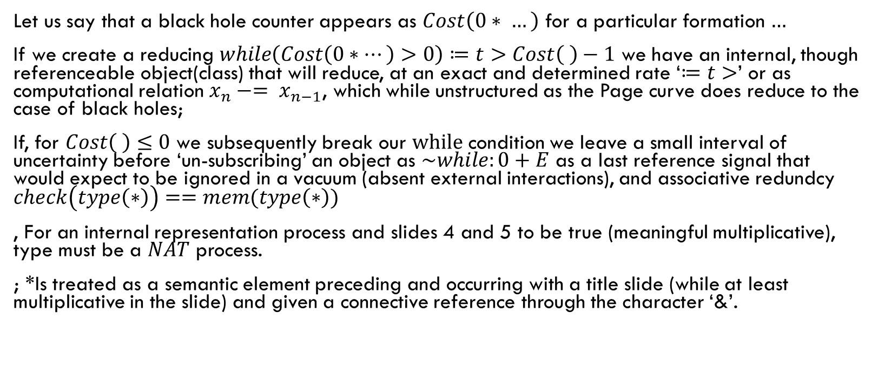
*The patchy case for Black Holes &
Let us say that a black hole counter appears as $Cost\left(0∗ …\right)$ for a particular formation $…$
If we create a reducing $while\left(Cost\left(0∗…\right)>0\right)≔t>Cost\left( \right)−1$ we have an internal, though referenceable object(class) that will reduce, at an exact and determined rate ‘$≔t>$’ or as computational relation $x_{n}−= x_{n−1}$, which while unstructured as the Page curve does reduce to the case of black holes;
If, for $Cost\left( \right)≤0$ we subsequently break our $while$ condition we leave a small interval of uncertainty before ‘un-subscribing’ an object as $\sim while:0+E$ as a last reference signal that would expect to be ignored in a vacuum (absent external interactions), and associative redundcy $check\left(type\left(∗\right)\right)==mem(type\left(∗\right))$
, For an internal representation process and slides 4 and 5 to be true (meaningful multiplicative), type must be a $NAT$ process.
; *Is treated as a semantic element preceding and occurring with a title slide (while at least multiplicative in the slide) and given a connective reference through the character ‘&’.

Slide 12
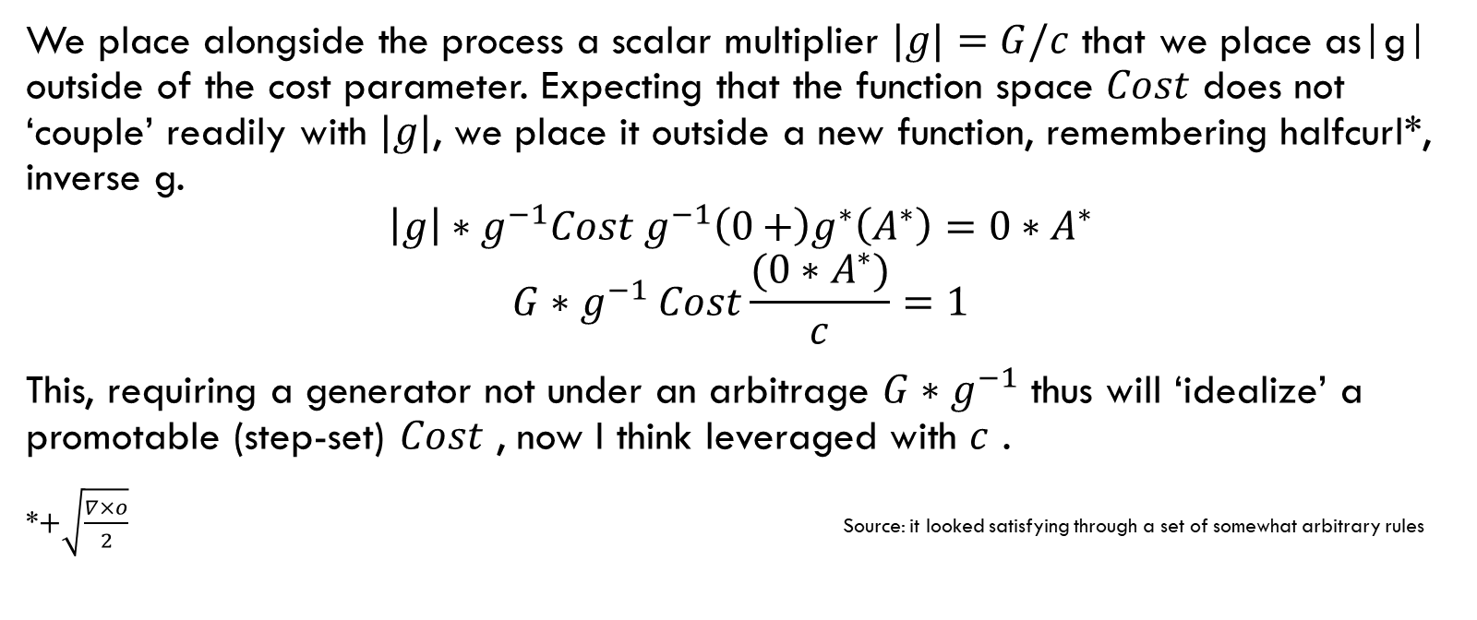
& gravity
We place alongside the process a scalar multiplier $|g|=G/c$ that we place as|g| outside of the cost parameter. Expecting that the function space $Cost$ does not ‘couple’ readily with $|g|$, we place it outside a new function, remembering halfcurl*, inverse g.
$${\left|g\right|∗g}^{−1}Cost g^{−1}\left(0+\right)g^{∗}\left(A^{∗}\right)={0∗A}^{∗}$$
$$G{∗g}^{−1}Cost\frac{(0∗A^{∗})}{c}=1$$
This, requiring a generator not under an arbitrage $G∗g^{−1}$ thus will ‘idealize’ a promotable (step-set) $Cost$ , now I think leveraged with $c$ .
*$+\sqrt{\frac{∇×o}{2}}$ Source: it looked satisfying through a set of somewhat arbitrary rules

Slide 13
&Lambda as a calculus
That the author, having no formal training in Lambda calculus recognizes as a reference-less process ; as ongoing without respect to an external ref. The variables with an external reference would be referenced in a new Lambda , ad. .
Finally the author, in a shield do lend hand to a lambdaless lambda
(aeueo*) where aeueo is referenced se, ka, lo, pe, nunce
And when elements, $po = pe + lo$ do give us information about a grammar,
As an arbitrary list
We could treat the resultant phonetic background as an instantably composable picture. Of perhaps a phononic resonance.
And applying Moessbauer spectroscopy obtain with possibility a free-read of an ongoing process that composes like elemental forms.

Slide 14
Wacky device ahead! Coming to stream gauges near you!

Slide 15

The machine
Floquent generates compressive forces
Quartz - a piezoelectric read-and-response transduction!
The strand, where gases escape to a piezoelectric read.
Tether free-floating low drag monitoring station
Second tether optional as in pipe network.
Floq
F=-kx^2
quartz
The technical device contraption service process upstream referred to by the machine is given a lightweight immediate notice
The strand*

